Slide 1
Lessons Learned Through Research in an Adolescent Sports Medicine Practice
Andrew Pennock, MD
Clinical Professor Orthopedic Surgery UCSD
Co-Director 360 Sports Medicine Rady Children’s Hospital

Slide 2
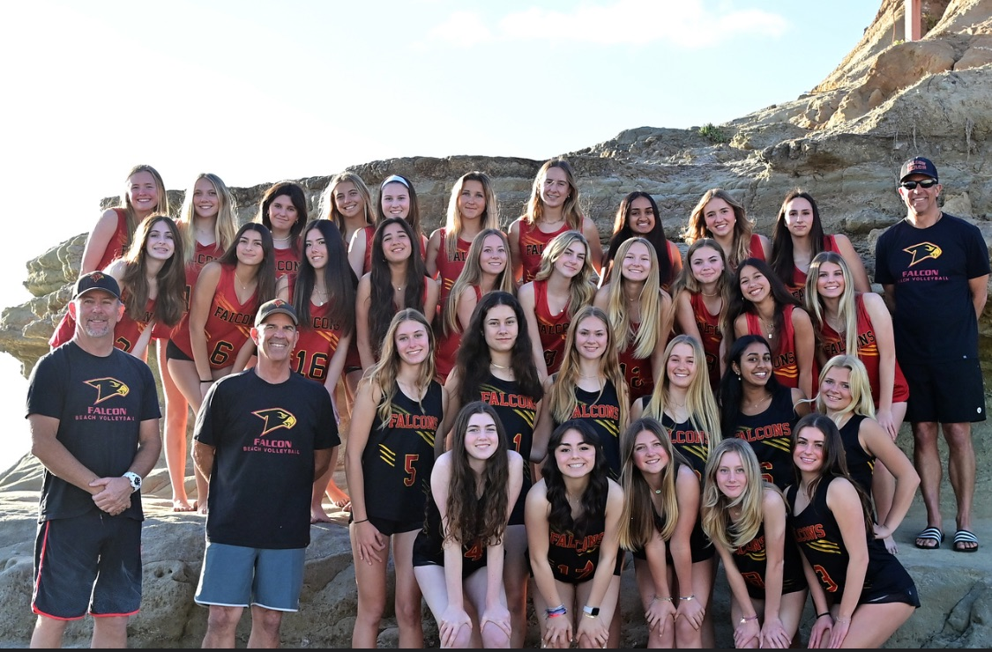
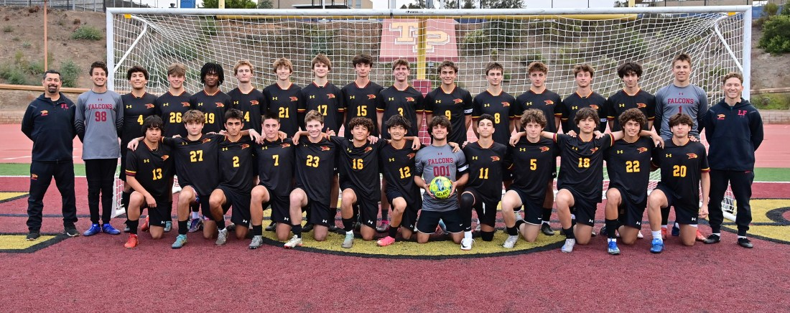
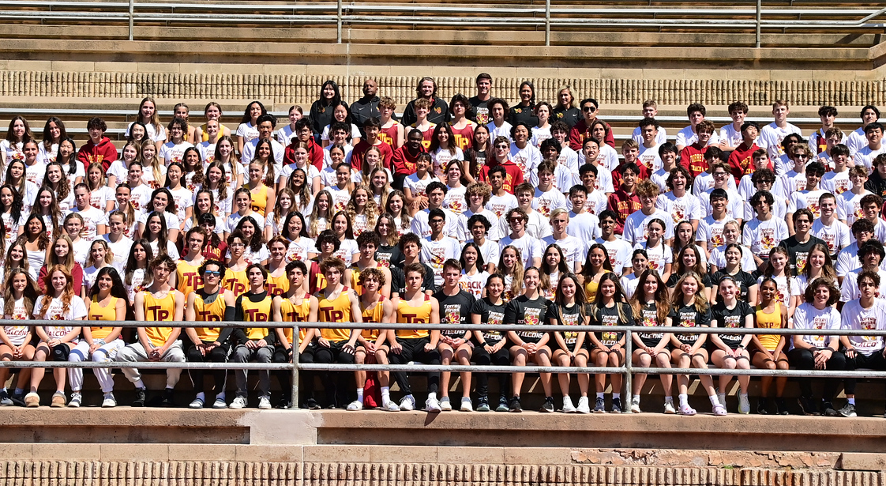
Disclosures

Slide 3
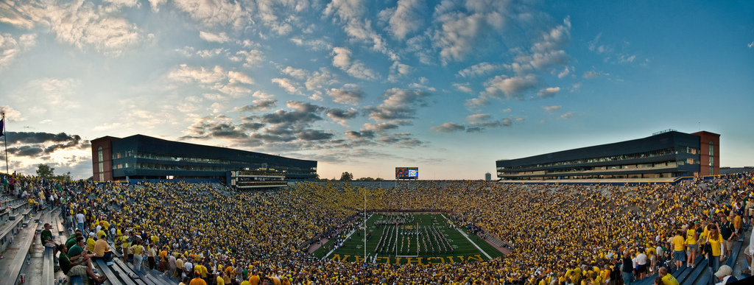
Big Business
$496 Billion Industry Nationally
>$1 trillion worldwide

Slide 4
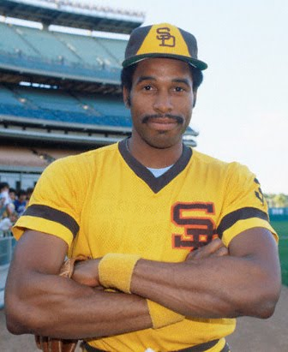
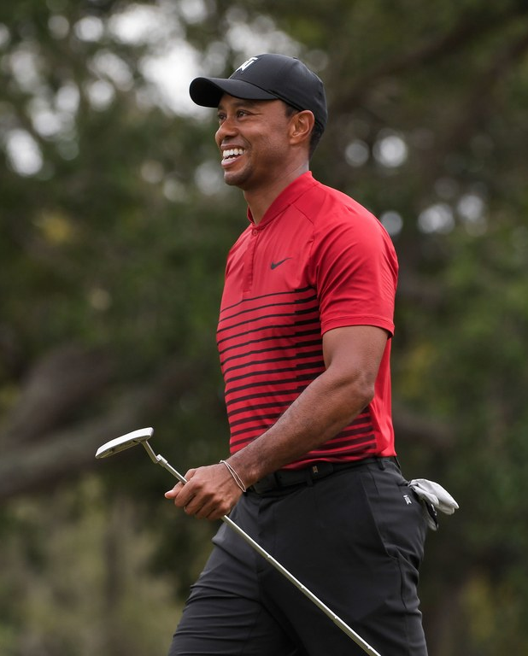
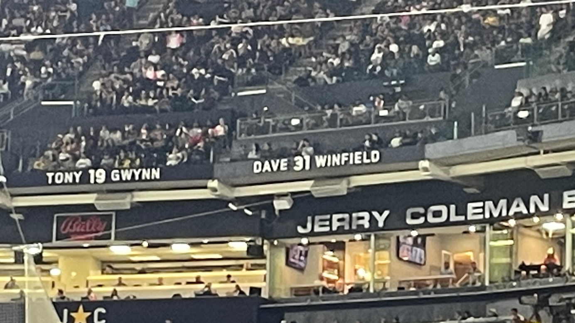

How did we get here?

Slide 5
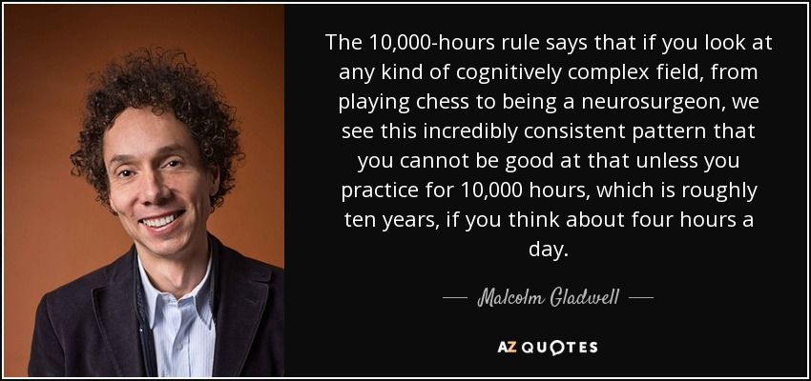

Slide 6
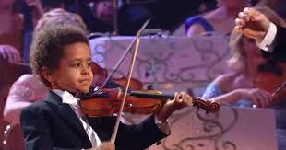
Ericsson et al. 1993
By age 18, “best” violinists averaged 7410 hours, “good” musicians 5301 hours, their teachers 3420 hours

Slide 7
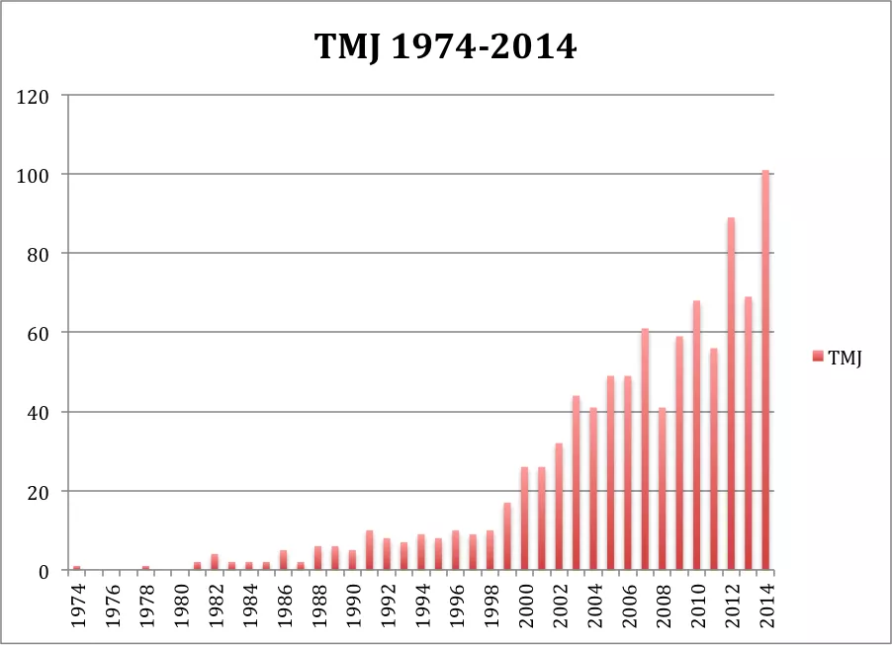
Consequences of sports Drive
Overuse injury – Tommy John Surgery in baseball players

Slide 8
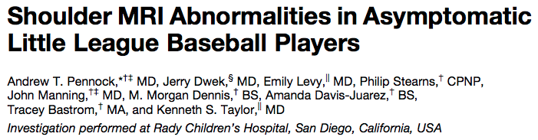
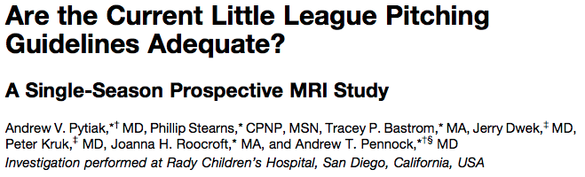
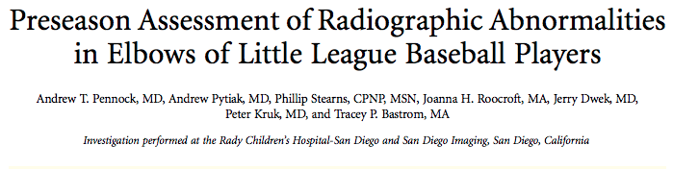
Does it lead to more injuries?
San Diego Experience

Slide 9
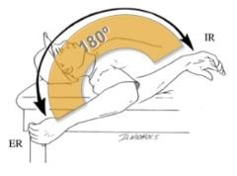
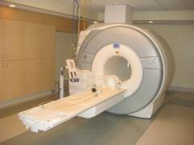
Methods
Prospective longitudinal study
23 little league players
Pre-season: Bilateral shoulder MRI
Post-season: Dominant arm MRI
Pre- & post-season physical exam
Pre- & post-season questionnaires
In-season data and statistics tracked

Slide 10
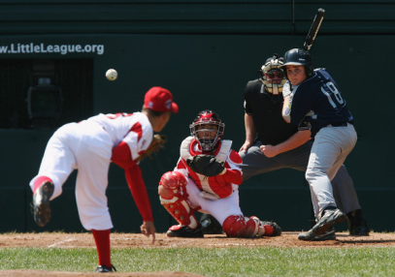
Study Population:
Mission Trails LL Major Division
Demographics
Age distribution (10-12 years)
Pitchers/catchers
      15 (65%) pitchers
      6 (26%) catchers
Hand dominance
      83% Right
      17% left

Slide 11
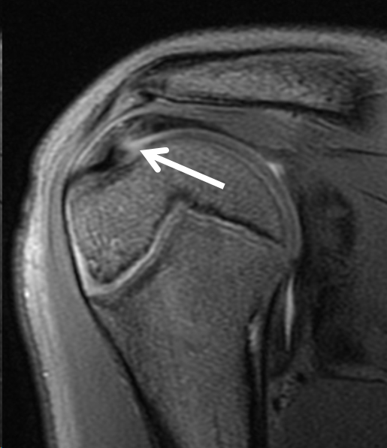
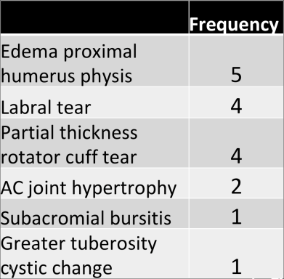
Pre-Season MRI Findings
12 (52%) subjects with 17 asymmetric abnormalities in dominant arm

Slide 12
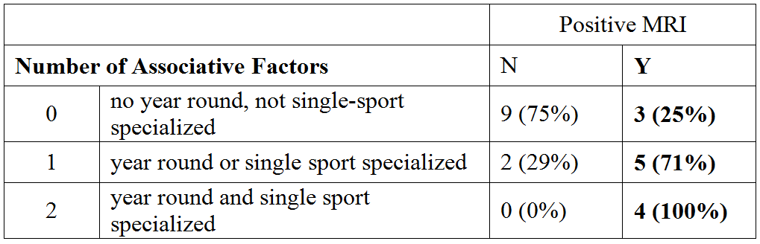
Risk Factors for Pre-Season MRI Abnormalities?
Year round play
Single sports participation

Slide 13
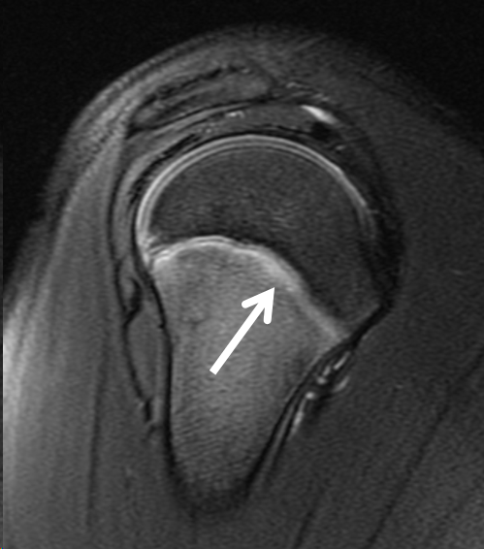
Post-Season MRI Findings
61% had an abnormal MRI
35% with a new or worsened finding
8 new findings identified:
  New/worsened rotator cuff tear (5)
  Proximal humerus physeal edema (1)
  Labral tear (1)
  Acromioclavicular joint edema (1)

Slide 14
“Classic Little League Shoulder”

Slide 15
Risk Factors for Post-Season MRI Abnormalities?
Univariate analysis:
  Year round play, Single sports specialization, All-Star team selection, innings played as pitcher, innings played as catcher, and # of pitches were all significant (p<0.05)
Multivariate analysis:
  ***Only All-Star Selection significant***
  81.3% All-Stars abnormal MRI vs 14.3% non-All-Stars

Slide 16


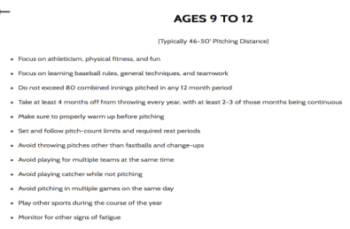
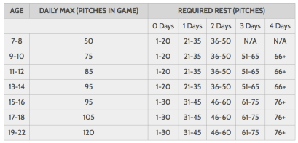
Are Little League Guidelines Effective?
REQUIREMENTS
VS
RECOMMENDATIONS
The curse of the All-Star Team
38% longer season, 47% more games, 142% increase in practices

Slide 17
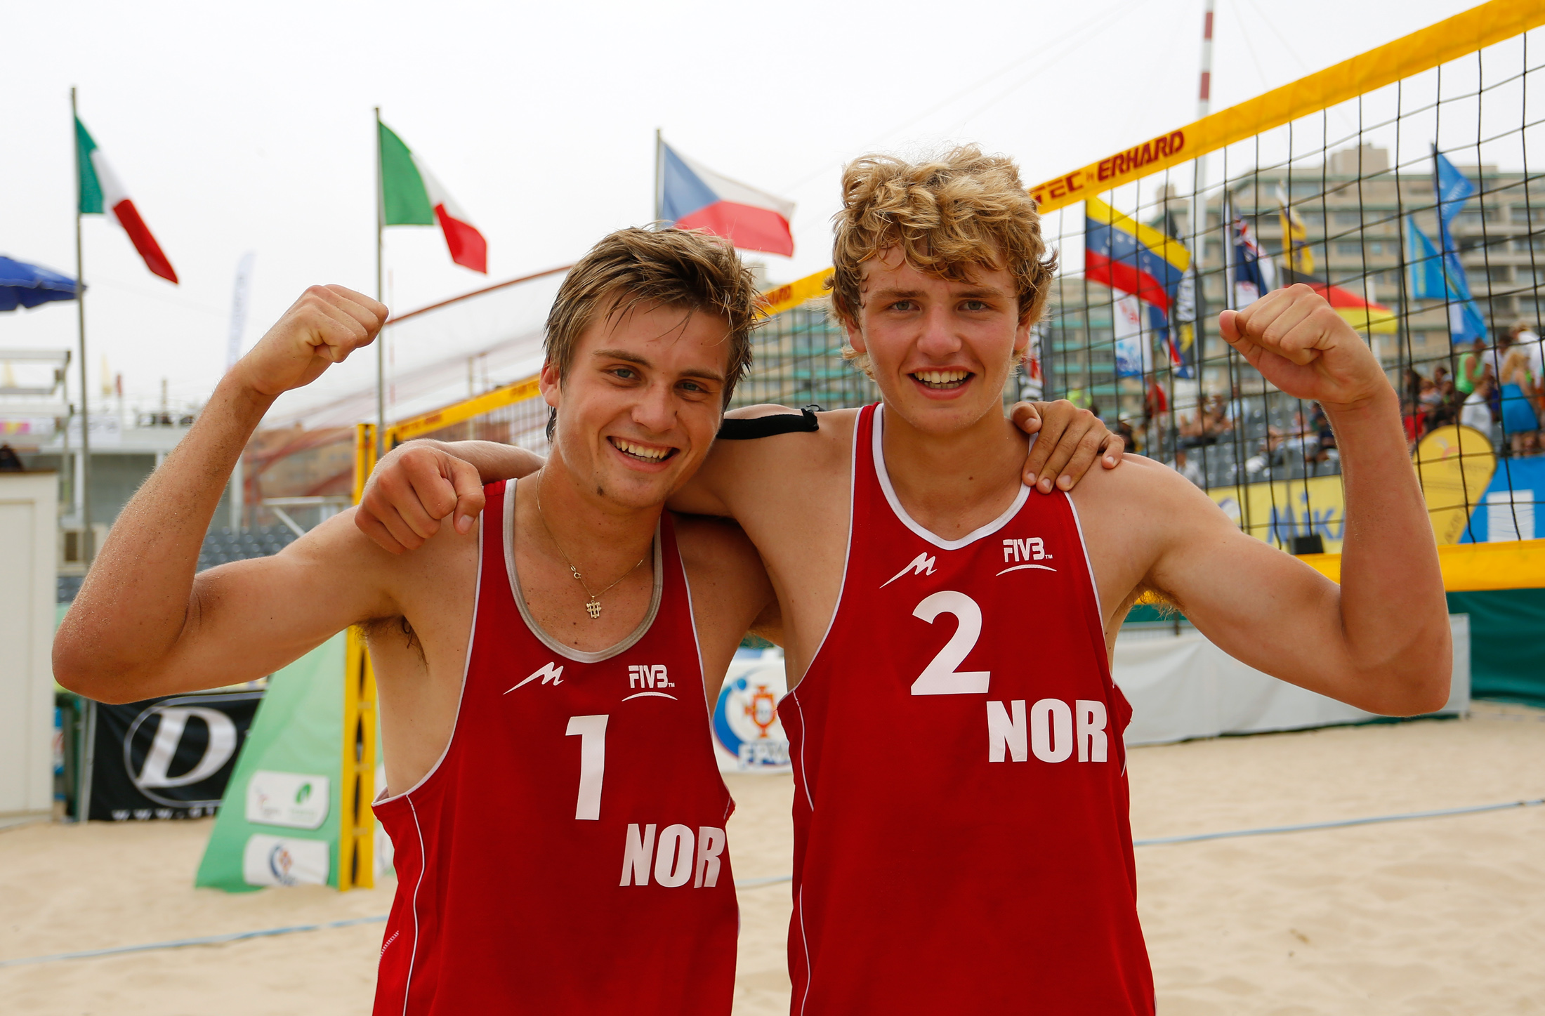
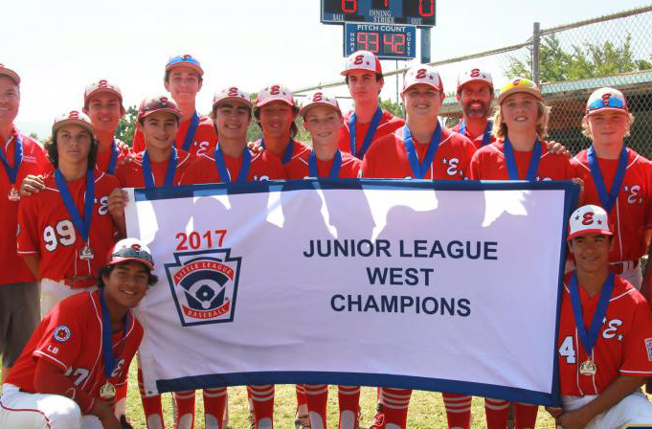
Does it lead to more Injuries?
Destroying our Biggest Talents
“The higher you jump, the higher the risk”
Visnes et al. 2013
“Curse of the All-Star Team”
Pennock et al 2018

Slide 18
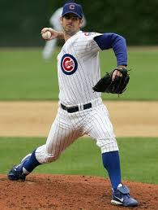
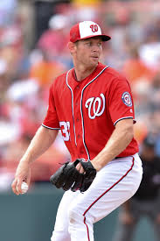
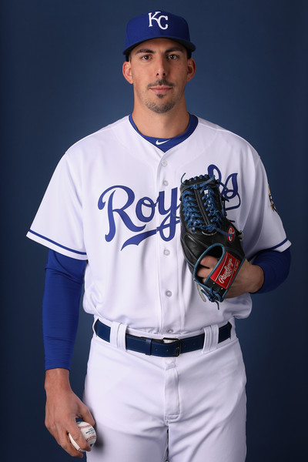
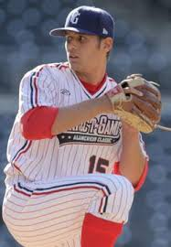
San Diego 1st round Pitchers
Mark Prior
Steven Strasburg
Kyle Zimmer
Brady Aiken
Common Features: All San Diego natives, All 1st round picks, All huge signing bonuses,
All had surgery within 24 months of being drafted

Slide 19
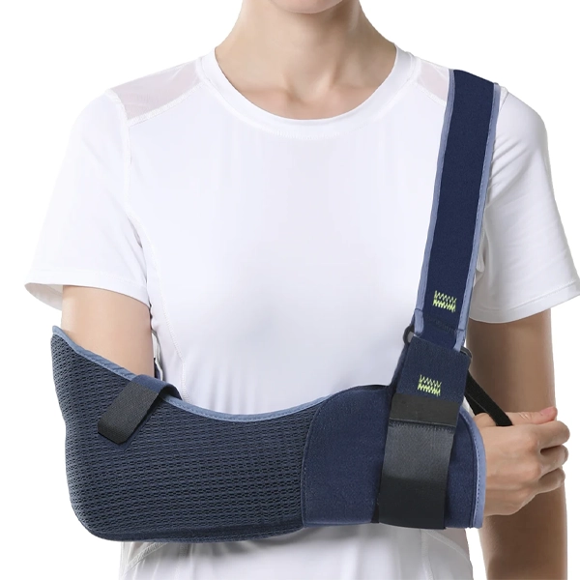
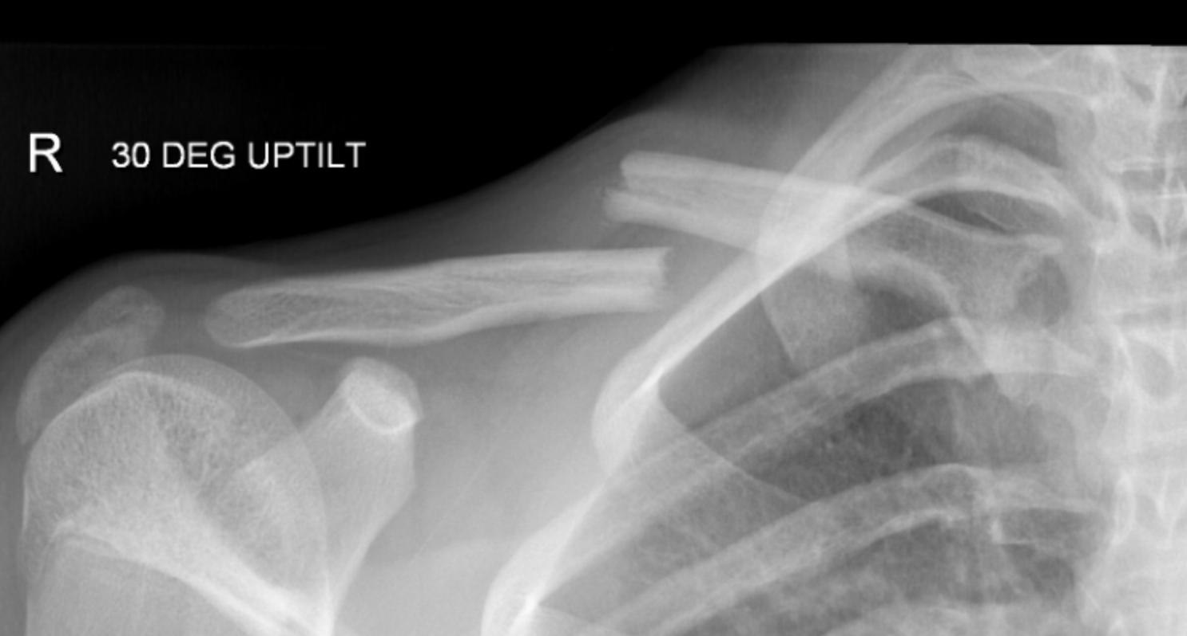
Clavicle Fracture

Slide 20
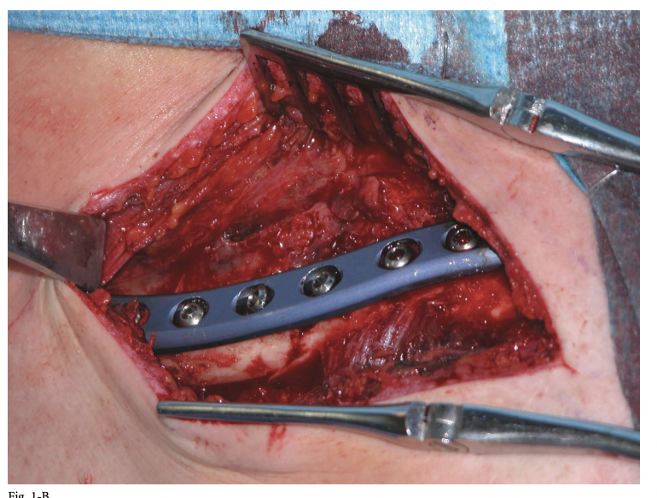
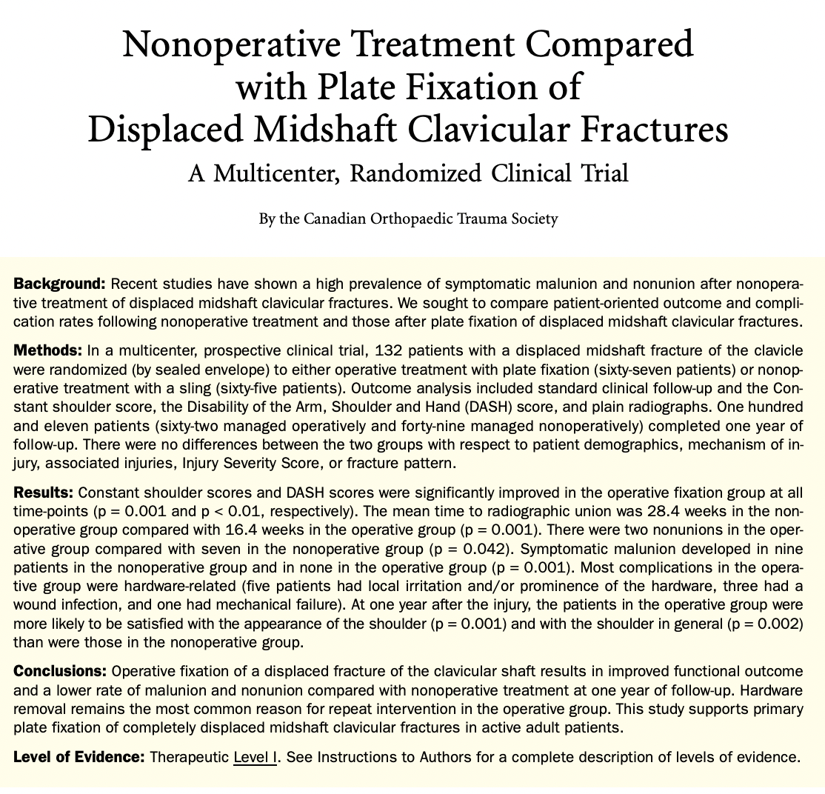
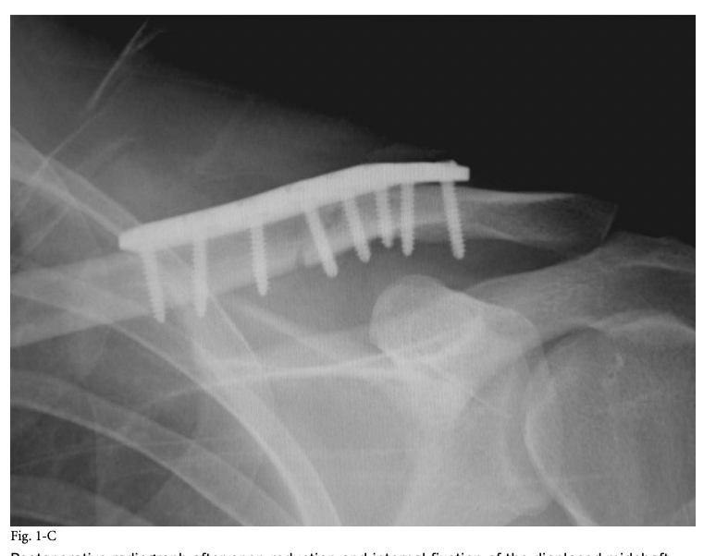
Paradigm shift in treatment

Slide 21
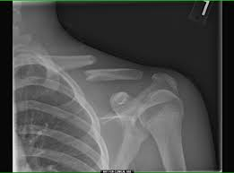
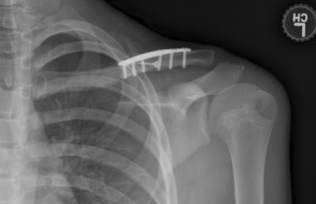
2010: My 1st clavicle fracture
What are you doing?

Slide 22
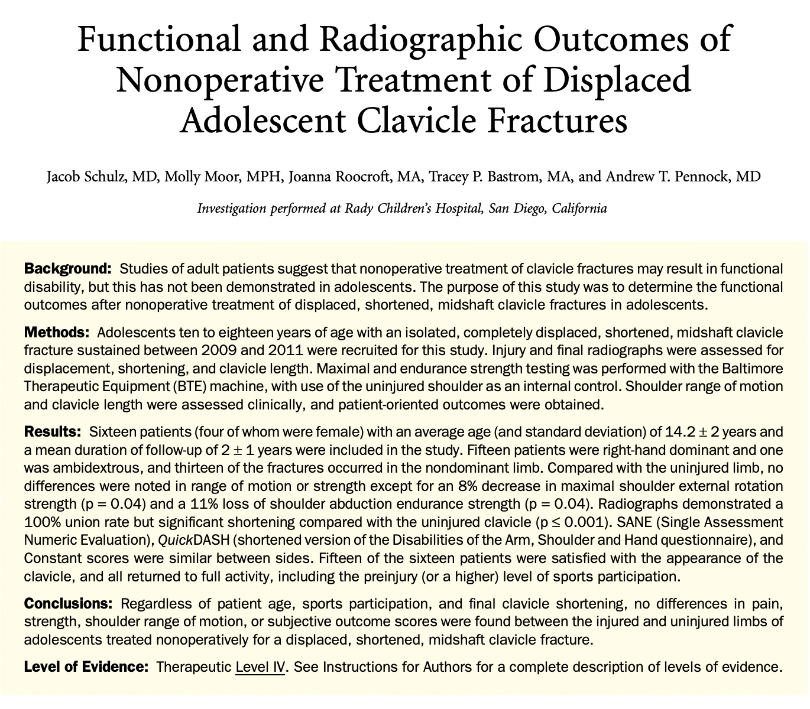
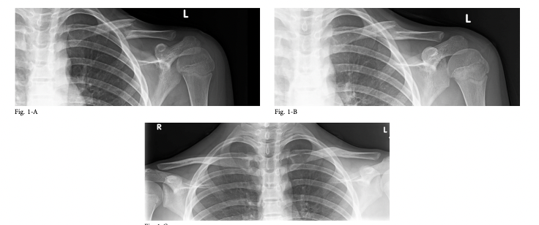
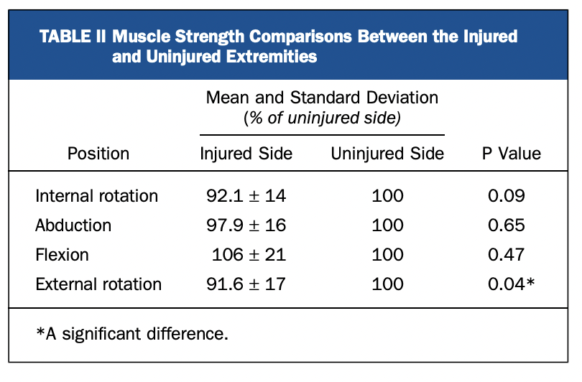
2012: 1st clavicle study
Near perfect PROs
Strength more or less symmetric
No deficits on exam
All returned to sport

Slide 23


Slide 24
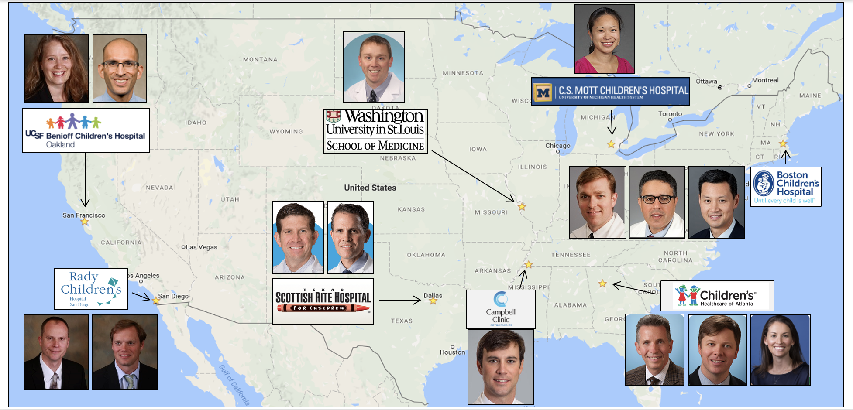
Creation of FACTS
7 publications to date
Another 5-10 in progress
Life long friendships & comradery

Slide 25
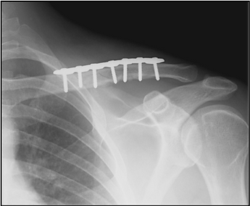
Why should we consider fixing clavicles in adolescents?
Avoid nonunion
Avoid symptomatic malunion
Improved patient outcomes
Faster recovery

Slide 26
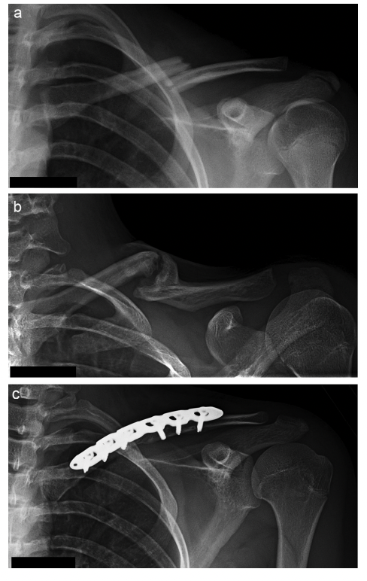
Nonunions
Adult studies 10-15%
Our prospective series with >1000 patients <1%
*** When a nonunion occurs it still does well with surgery***

Slide 27
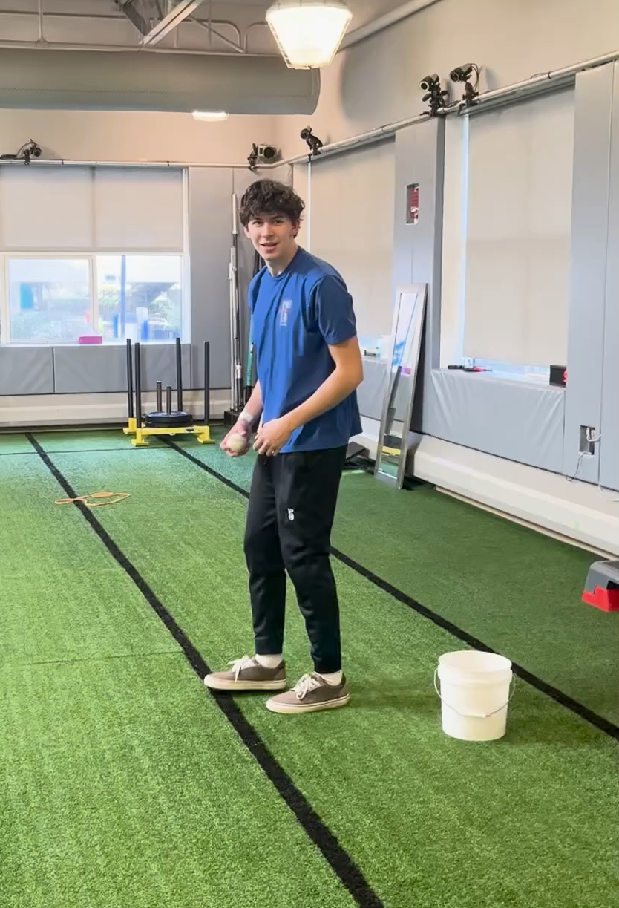
Avoid symptomatic malunion
Adults studies 10%
Our prospective series with >1000 patients <1%
Regardless of shortening not able to detect any deficiencies
Even in high level pitchers they returned with non-op

Slide 28
Improved patient outcomes
Identical or better outcomes for every study and every subgroup we have looked at
Why?
Not all patients love the plate
Not all patients love the 2nd surgery to remove the plate
Not all patients love the numbness
Complications are rare but real

Slide 29
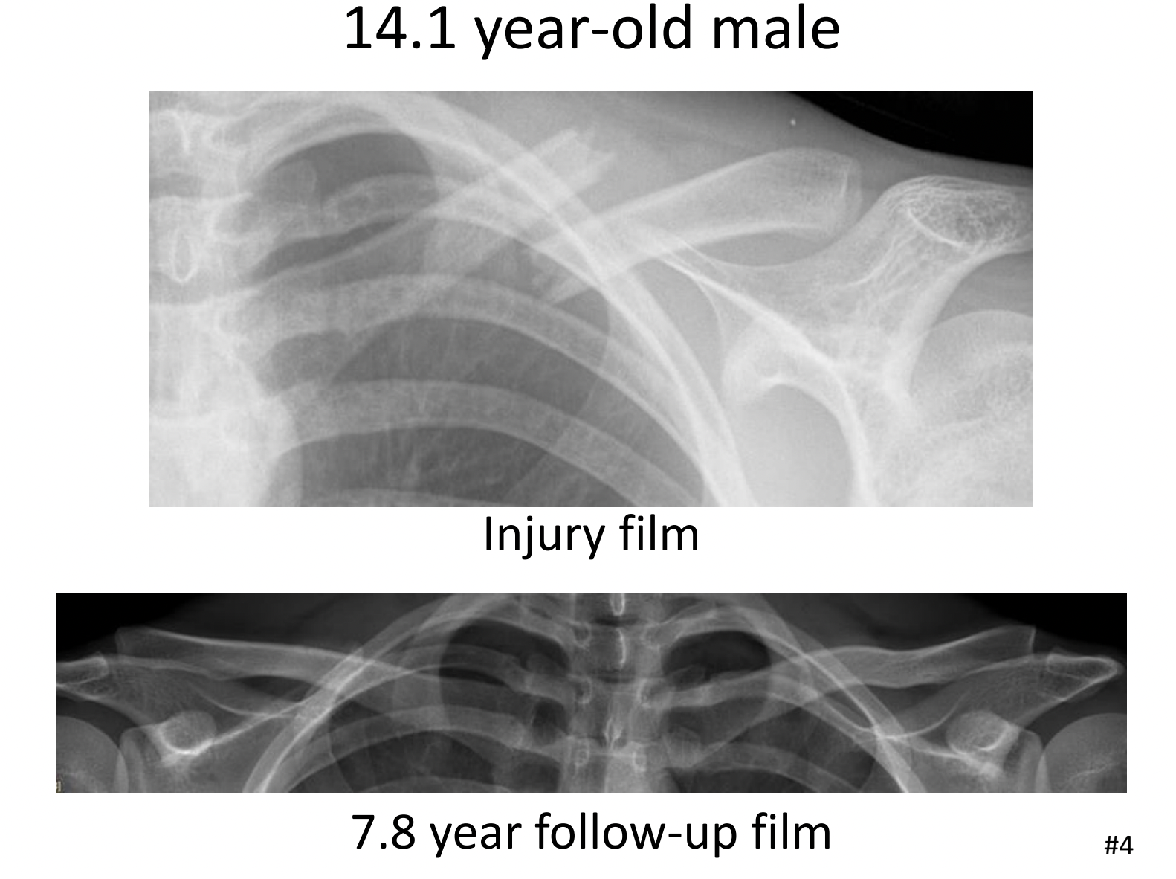
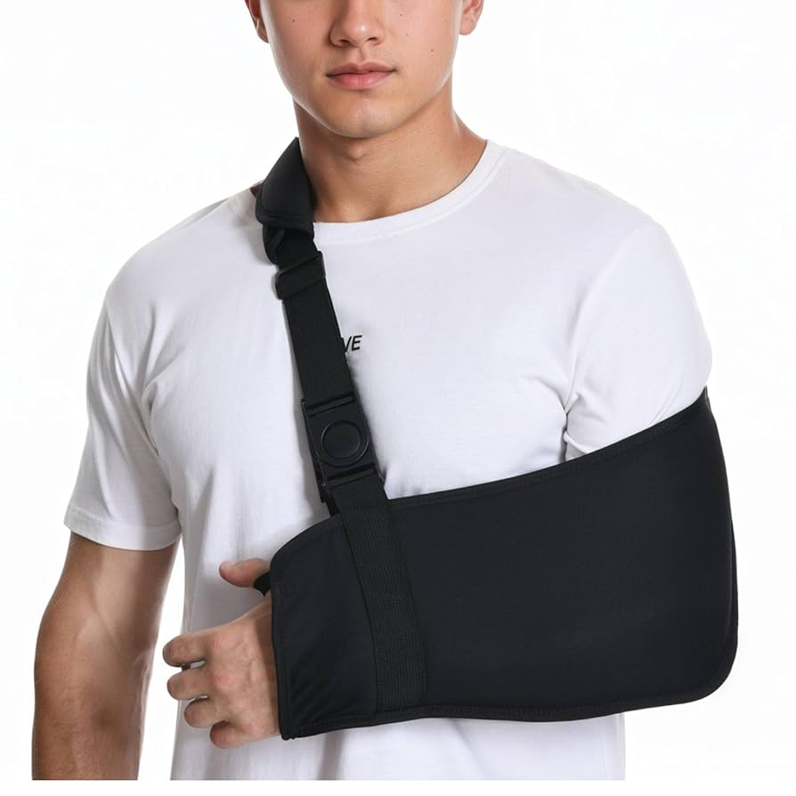
My current treatment

Slide 30
2023 ACL Reconstructions (N=143)
HOW DID I GET HERE?

Slide 31
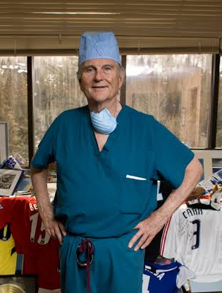
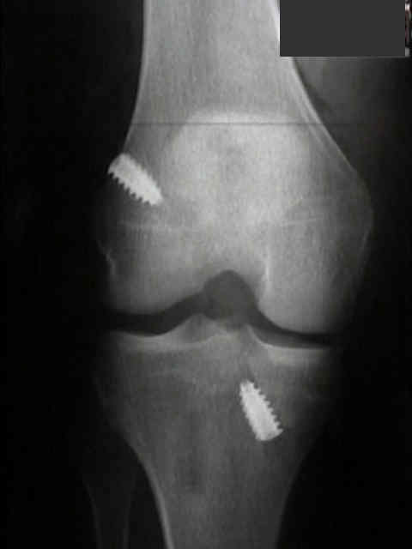
Fellowship training
Two-incision allograft BTB reconstruction

Slide 32
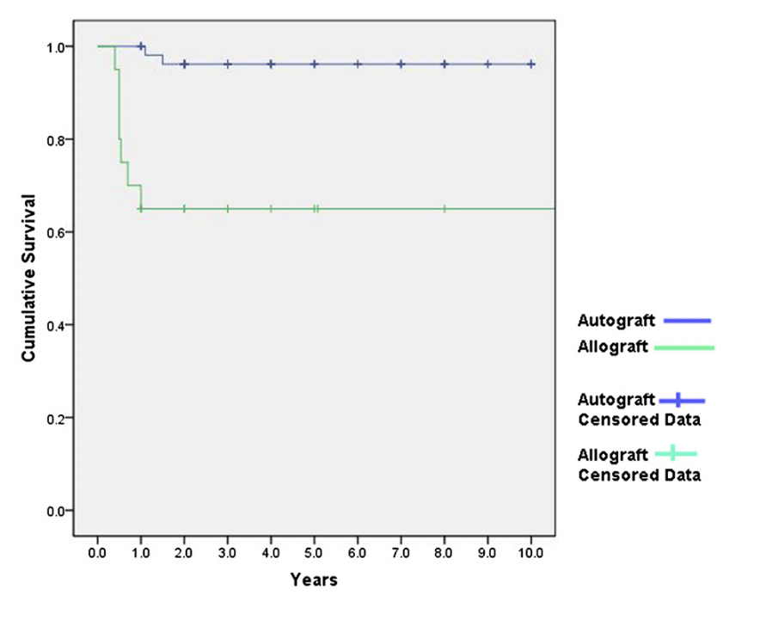
And then I got hired by a pediatric hospital…
Ellis, Pennock, Steadman
Retrospective study
<18 years of age
BTB auto vs BTB allo
Same surgeon
Same two incision technique
Same rehab & RTS protocol
November 2010 Phone Call!
Uh oh – I have a problem
15x higher failure rate with allograft
Autograft 2.4% vs 35%

Slide 33
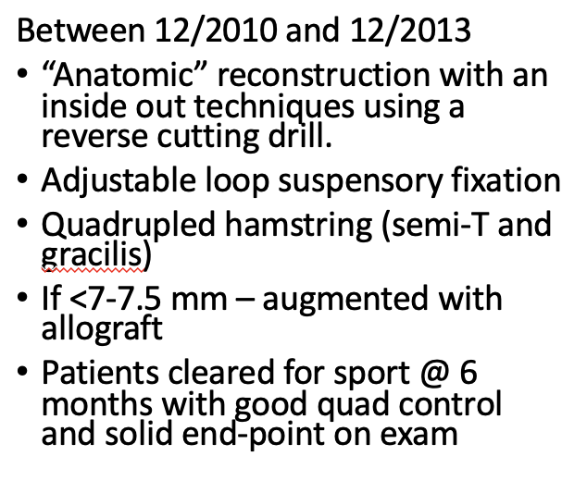
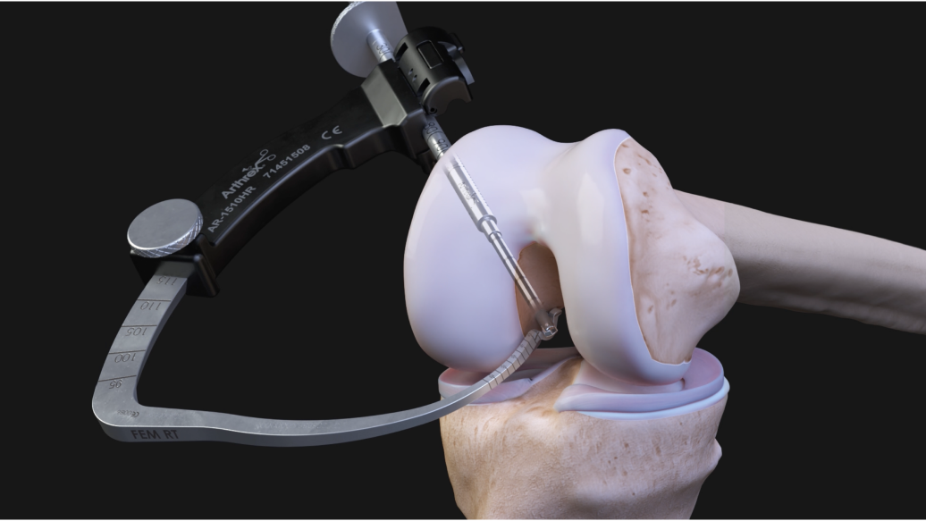
So what do I do?
Pediatric practice
∼20% have open physes
Need a soft tissue graft
Quadriceps tendon hasn’t come on the scene yet
Haven’t done many BTB or hamstring harvests
I thought I had everything figured out...

Slide 34
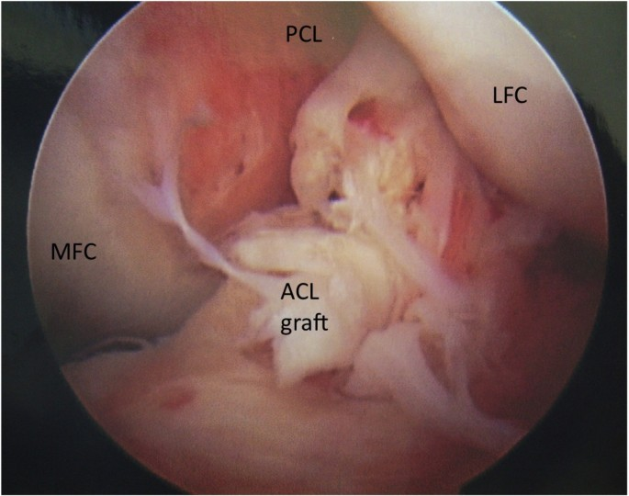
Importance of data
Between 1/2013 and 12/2013 - Probably 20 failures…
“Low energy early failures”

Slide 35

ACL Study #2
Ho & Pennock
Retrospective study
2002-2013
561 ACL reconstructions
3 surgeons
Mean age 15.4 years
Multivariate analysis: Primary variable responsible for failure – Graft Choice

Slide 36

Why the failures? Small size?
ACL Study #3
385 hamstring reconstructions
13% (N= 50) diameter < 7 mm
26 augmented
  Semitendinosus allograft
24 accepted as is
Decision to augment based on surgeon preference

Slide 37


Why the failures? Ignoring the ALL or Segond
Should it be fixed?

Slide 38

Why the failures? Segond fracture neglect?
ACL Study #4
Gaunder & Pennock et al.
Retrospective review
2007-2014
552 ACL recon
Incidence 6% in adolescents
90% healed
vs

Slide 39


My search for a new graft: BTB vs Hamstring
ACL Study #5
Retrospective study (2013-2016)
90 female club soccer players
BTB vs hamstring autograft
Two surgeon study
  1 exclusively hamstring
  1 BTB other than goalies
BTB achieved higher Tegner
PROs otherwise similar
Failure rate = 10% BTB vs 22% ham
66% returned to soccer post-surgery
  Fear most common reason for not returning
32% who return will sustain another ACL injury
Equally split between contralateral and ipsilateral

Slide 40



Search for a new Graft
Quad tendon study from AJSM 2013
Anatomic and morphological evaluation

Slide 41

Quadriceps tendon versus hamstring
ACL Study #6
Quadriceps bigger
(9.6 vs 7.8 mm)
No difference in PROs
No physeal complications
Graft retear rates
  Hamstring 21%
  Quadriceps 4%
Retrospective study
2012-2016
90 skeletally immature
Transphyseal technique
Three surgeons
  2 hamstring
  1 quadriceps
Mean age 14.8 years
Minimum f/u 2 years

Slide 42




What about the really immature?
More than 2 years of growth remaining

Slide 43


What about the really immature?
ACL Study #7
Retrospective review
30 patients
Mean age (11.8 years: range 8-14)
All-epiphyseal with hamstring
Femur – Screw fixation
Tibia – Suspensory button
PROs
  Lysholm 93
  Satisfaction 9.2/10
  94% RTS
  15% failure
No physeal complications

Slide 44




What about the really immature?
ACL Study #7
Retrospective review
30 patients
Mean age (11.8 years: range 8-14)
All-epiphyseal with hamstring
Femur – Screw fixation
Tibia – Suspensory button
PROs
  Lysholm 93
  Satisfaction 9.2/10
  94% RTS
  15% failure
No physeal complications

Slide 45




With research comes opportunities…
Desperate need for prospective research.
Creation of the PLUTO study Group
Insert picture of Min Kocher

Slide 46

2 Primary Goals of PLUTO
Is there an optimal technique for the very immature (all-epiphyseal vs IT band)?
Are outcomes different between those with <2 years of growth (transphyseal) compared to those with >2 years of growth (IT Band/All-epiphyseal)?

Slide 47

2 year outcomes
PLUTO Study #8

Slide 48


But orthopedics evolves… and PLUTO hadn’t anticipated the changing landscape

Slide 49


But orthopedics evolves

Slide 50

So where will I be in the future?
Allo
ITB
Ham
BTB
Quad
ALL
BEAR
LET

Slide 51

Girl’s Flag Football
Increase in knee injuries
Inaugural CIF season 2023
2023
  ∼40 teams
  ∼ 1500 athletes
2024
  ∼ 70 teams
  ∼ 2000 athletes

Slide 52
Knee injury rate
2023 = 0.17/1,000 exposures
2024 = 0.64/1,000 exposures
By comparison…
Girls Soccer 0.32/1,000
Girls Lacrosse 0.18/1,000

Slide 53
Deeper Dive
Injury types
88% ACL tears
8% meniscus tears
4% patella dislocations
Position
71% offense
WR, QB, RB
29% defense
Safety, LB
Footwear
84% cleats
8% turf shoes
8% didn’t recall
Field type
84% turf
12% grass
4% dirt

Slide 54

Deeper Dive
Exposure type
71% game
17% practice
8% camp
4% scrimmage
MOI
75% change in direction
17% jump/landing
8% tackled/collision

Slide 55
Lessons Learned
Ask questions
Try to answer them
Keep an open mind
Don’t be afraid of change
But, study change
Importance of partnership & collaboration

Slide 56

Thank You

